Slide 1
SOME DATA COLLECTION TECHNIQUES
Critical Incident Identification
During an evaluation session, you cannot always see the interaction design flaws directly. What we can observe directly or indirectly are the effects of those design flaws on the users. We refer to such effects on the users during interaction as critical incidents.
A critical incident is an event observed within task performance that is a significant indicator of some factor defining the objective of the study.
Critical incidents are indicators of “something notable” about usability or the user experience.
The best kind of critical incident data are detailed, observed during usage, and associated closely with specific task performance.
Critical incidents are observed directly by the facilitator or other observers and are sometimes expressed by the user participant.

Slide 2
SOME DATA COLLECTION TECHNIQUES
Critical Incident Identification
Critical incident data about a UX problem should contain as much detail as possible, including contextual information, such as:
the user’s general activity or task
the specific user intention and action that led immediately to the critical incident
expectations of the user about what the system was supposed to do when the critical incident occurred
what happened instead
as much as possible about the mental and emotional state of the user
indication of whether the user could recover from the critical incident and, if so, a description of how the user did so
additional comments or suggested solutions to the problem

Slide 3
SOME DATA COLLECTION TECHNIQUES
Critical Incident Identification
Timing of critical incident data capture: The evaluator’s awareness zone
If you capture them as they happen, we call it concurrent data capture. If you capture data immediately after the task, we call it contemporaneous data capture. If you try to capture data after the task is well over, through someone trying to remember the details in an interview or survey after the session, this is retrospective data capture and many of the once-fresh details can be lost.
It is not as easy, however, as just capturing critical incident data immediately upon its occurrence. A critical incident is often not immediately recognized for what it is. The evaluator’s recognition of a critical incident wilh necessarily occur sometime after it begins to occur. And following the point of initial awareness, after confirming that it is a critical incident, the evaluator requires some time and thought in a kind of “awareness zone” to develop an understanding of the problem, possibly through discussion with the participant.

Slide 4
SOME DATA COLLECTION TECHNIQUES
The Think-Aloud Technique
Also called “think-aloud protocol” or “verbal protocol,” the think-aloud technique is a qualitative data collection technique in which user participants, as the name implies, express verbally their thoughts about their interaction experience, including their motives, rationale, and perceptions of UX problems. By this method, participants let us in on their thinking, giving us access to a precious understanding of their perspective of the task and the interaction design, their expectations, strategies, biases, likes, and dislikes.
The bulk of real UX problem data is hidden from observation, in the mind of the participant. What is really causing a hesitation and why does this participant perceive it as a problem or barrier? To get the best qualitative data, you have to tap into this hidden data, buried in the participant’s mind, which is the goal of the think-aloud technique.

Slide 5
SOME DATA COLLECTION TECHNIQUES
The Think-Aloud Technique
What kind of participant works best?
The usual participant for think-aloud techniques is someone who matches the work role and user class definitions associated with the tasks you will use to drive the evaluation. This kind of participant will not be trained as a UX practitioner, but that usually will not deter them from offering opinions and theories about UX problems and causes in your design, which is what you want.
That it is your job to accept their comments as inputs to your process and it is still up to you to filter and interpret all think- aloud data in the context of your design.
Is thinking aloud natural for participants?

Slide 6
SOME DATA COLLECTION TECHNIQUES
Questionnaires
A questionnaire is the primary instrument for collecting subjective data from participants in all types of evaluations. It can be used to supplement objective (directly observable) data from lab-based or other data collection methods or as an evaluation method on its own. A questionnaire can contain probing questions about the total user experience. Although post-session questionnaires have been used primarily to assess user satisfaction, they can also contain effective questions oriented specifically toward evaluating broader emotional impact and usefulness of the design.

Slide 7
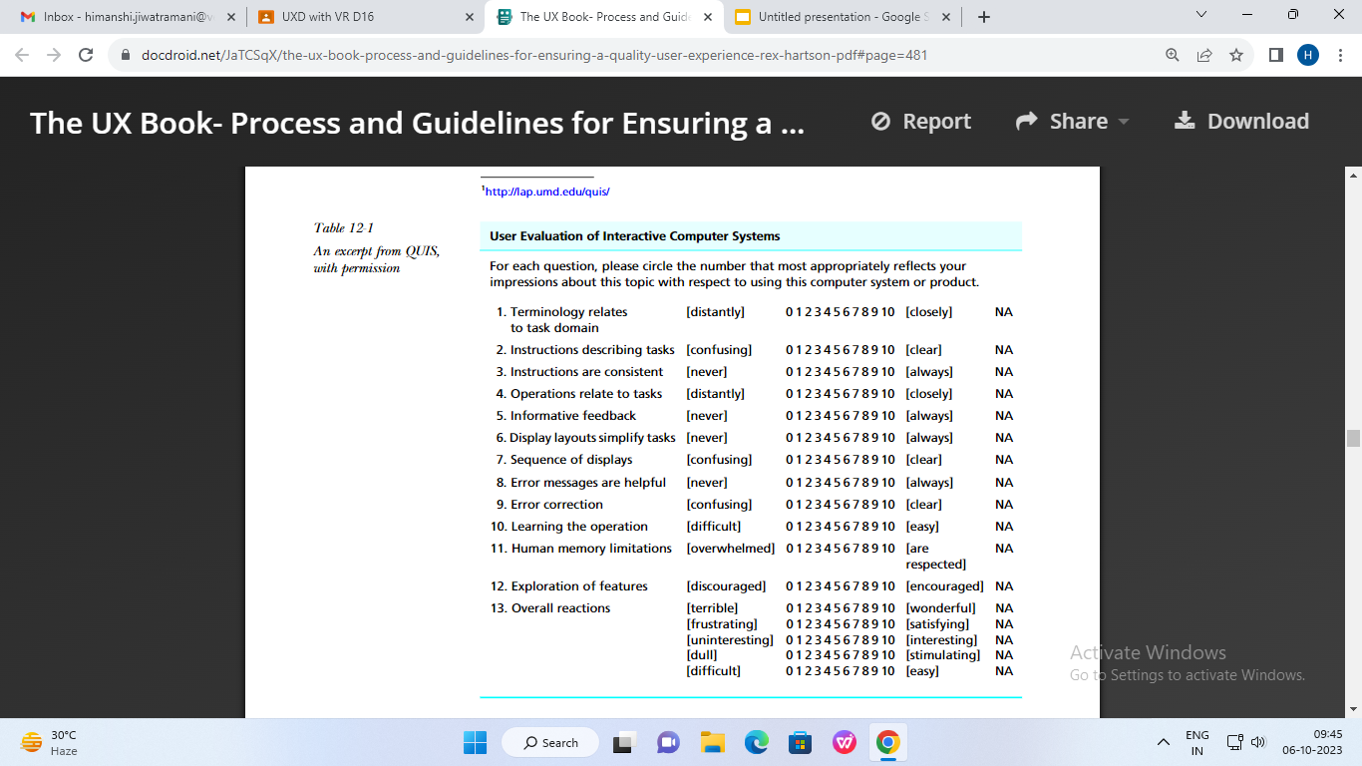
SOME DATA COLLECTION TECHNIQUES
Questionnaires
The Questionnaire for User Interface Satisfaction (QUIS)

Slide 8
SOME DATA COLLECTION TECHNIQUES
Questionnaires
The System Usability Scale (SUS)
The questions are presented as simple declarative statements, each with a five- point Likert scale anchored with “strongly disagree” and “strongly agree” and with values of 1 through 5. These 10 statements are (used with permission):
I think that I would like to use this system frequently
I found the system unnecessarily complex
I thought the system was easy to use
I think that I would need the support of a technical person to be able to use this system
I found the various functions in this system were well integrated
I thought there was too much inconsistency in this system
I would imagine that most people would learn to use this system very quickly
I found the system very cumbersome to use
I felt very confident using the system
I needed to learn a lot of things before I could get going with this system

Slide 9
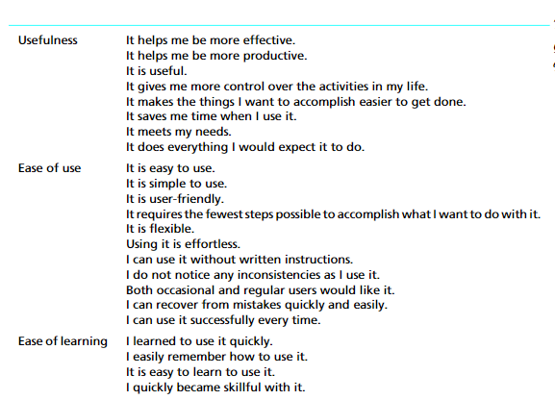
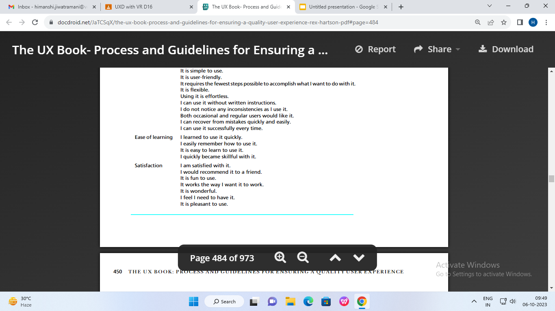
SOME DATA COLLECTION TECHNIQUES
Questionnaires
The Usefulness, Satisfaction, and Ease of Use (USE)

Slide 10
Rapid Evaluation Methods
Here are some of the general characteristics of rapid evaluation methods:
Rapid evaluation techniques are aimed almost exclusively at finding qualitative data—finding UX problems that are cost-effective to fix.
Seldom, if ever, is attention given to quantitative measurements.
There is a heavy dependency on practical techniques, such as the “think-aloud” technique.
Everything is less formal, with less protocol and fewer rules.
There is much more variability in the process, with almost every evaluation “session” being different, tailored to the prevailing conditions.
This freedom to adapt to conditions creates more room for spontaneous ingenuity, something experienced practitioners do best.

Slide 11
DESIGN WALKTHROUGHS AND REVIEWS
The goal of a design walkthrough is to explore a design on behalf of users to simulate the user’s view of moving through the design, but to see it with an expert’s eye. The team is trying to anticipate problems that users might have if they were the ones using the design.
What materials do you need upfront? You should prepare for a design walkthrough by gathering at least these items:
Design representation(s), including storyboards, screen sketches, illustrated scenarios (scenario text interspersed with storyboard frames and/or screen sketches), paper prototypes, and/or higher fidelity prototypes
Descriptions of relevant users, work roles, and user classes
Usage or design scenarios to drive the walkthrough

Slide 12
UX INSPECTION
When we use the term “UX inspection,” we are aware that you cannot inspect UX but must inspect a design for user experience issues.
A UX inspection is an “analytical” evaluation method in that it involves evaluating by looking at and trying out the design yourself as a UX expert instead of having participants exercise it while you observe. Here we generalize the original concept of usability inspection to include inspection of both usability characteristics and emotional impact factors and we call it UX inspection.
Because the process depends on the evaluator’s judgment, it requires an expert, a UX practitioner or consultant, which is why this kind of evaluation method is also sometimes called “expert evaluation” or “expert inspection.”

Slide 13
UX INSPECTION
Inspection Is a Valuable Tool in the UX Toolbox
Where they are applied in early stages and early design iterations.
Where you should save the more expensive and more powerful tools, such as lab-based testing, for later to dig out the more subtle and difficult problems.
Where you have not yet done any other kind of evaluation.
Where you cannot afford or cannot do lab-based testing for some reason but still want to do some evaluation.
How Many Inspectors Are Needed?
In UX inspection, to improve effectiveness you can add more inspectors. But does it help? Yes, for inspections, a team approach is beneficial, maybe even necessary, because low individual detection rates preclude finding enough problems by one person. The number depends on conditions and a great deal on the system you are inspecting.

Slide 14
UX INSPECTION
What Kind of Inspectors Are Needed?
Sometimes it is best to get a fresh view by using an expert evaluator who is not on the project team. If those UX experts also have knowledge in the subject-matter domain of the interface being evaluated, all the better. Those people are called dual experts and can evaluate through both a design guidelines perspective and a work activity, workflow, and task perspective.

Slide 15
HEURISTIC EVALUATION, A UX INSPECTION METHOD
The heuristic evaluation (HE) method has the advantages of being inexpensive, intuitive, and easy to motivate practitioners to do, and it is effective for use early in the UX process. Therefore, it is no surprise that of all the inspection methods, the HE method is the best known and the most popular. Another important point about the heuristics is that they teach the designers about criteria to keep in mind while doing their own designs so they will not violate these guidelines.

Slide 16
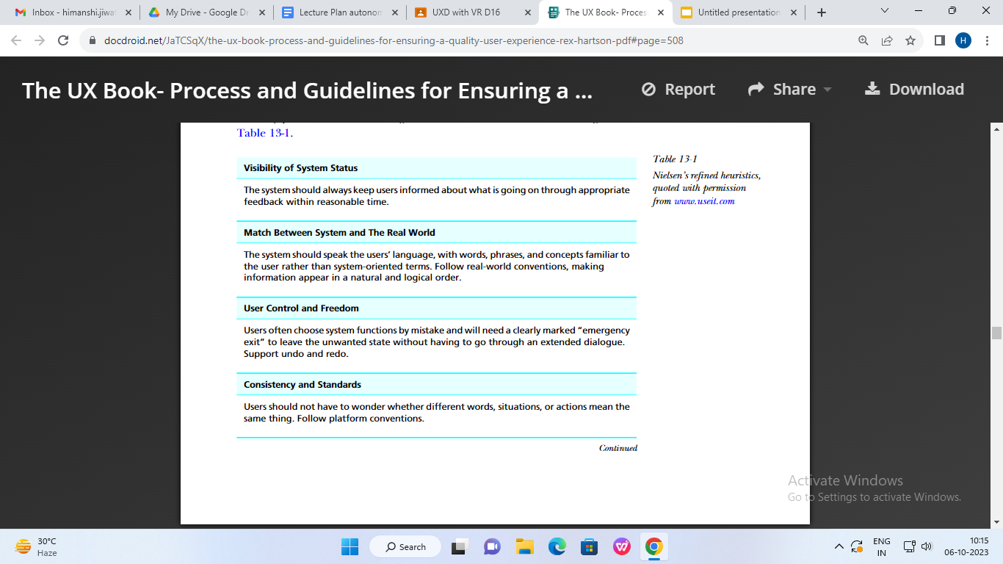
How-to-Do-It: Heuristic Evaluation
Heuristics

Slide 17
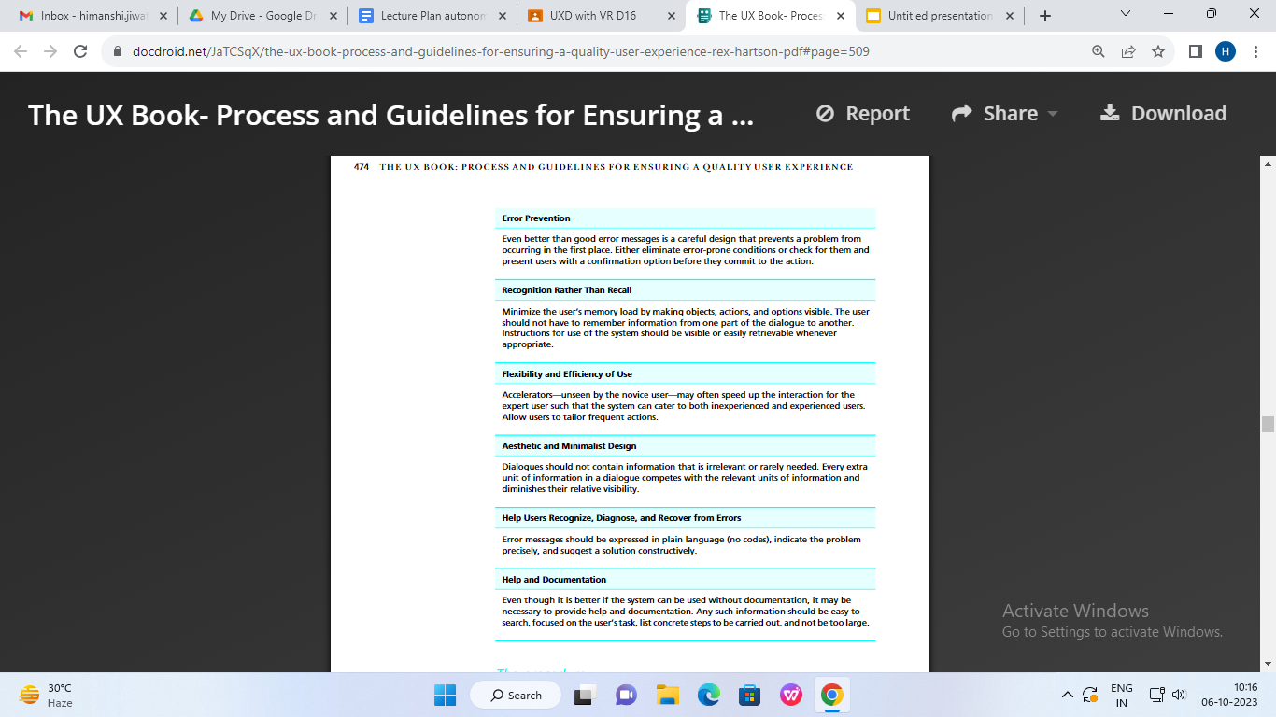
How-to-Do-It: Heuristic Evaluation
Heuristics

Slide 18
The procedure
These inspection sessions can take from a couple of hours for small systems to several days for larger systems. Here is how to do it:
The project team or manager selects a set of evaluators, typically three to five.
The team selects a small, tractable set, about 10, of “heuristics,” generalized and simplified design guidelines in the form of inspection questions, for example, “Does the interaction design use the natural language that is familiar to the target user?” The set of heuristics given in the previous section are a good start.
Each inspector individually browses through each part of the interaction design, asking the heuristic questions about that part:
assesses the compliance of each part of the design
notes places where a heuristic is violated as candidate usability problems
notes places where heuristics are supported (things done well)
identifies the context of each instance noted previously, usually by capturing an
image of the screen or part of the screen where the problem or good design feature occurs

Slide 19
The procedure
All the inspectors get together and, as a team, they:
merge their problem lists
select the most important ones to fix
brainstorm suggested solutions
decide on recommendations for the designers based on the most frequently visited screens, screens with the most usability problems, guidelines violated most often, and resources available to make changes
issue a group report

Slide 20
A heuristic evaluation report should:
start with an overview of the system being evaluated
give an overview explanation of inspection process
list the inspection questions based on heuristics used
report on potential usability problems revealed by the inspection, either:
by heuristic—for each heuristic, give examples of design violations and of ways the design supports the heuristic
by part of the design—for each part, give specific examples of heuristics violated and/ or supported
include as many illustrative screen images or other visual examples as possible.

Slide 21
QUASI-EMPIRICAL UX EVALUATION
Introduction
Quasi-empirical UX evaluation methods are empirical because they involve taking some kind of data using volunteer participants.
Most empirical methods are characterized by formal protocols and procedures. Thus, the qualifier “quasi.” Most empirical methods have at least some focus on quantitative data; quasi- empirical approaches have none.
Quasi-empirical testing can occur almost anywhere, including UX lab space, a conference room, an office, a cafeteria, or in the field.Quasi-empirical methods are defined by the freedom given to the practitioner to innovate, to make it up as they go. Quasi-empirical evaluation sessions mean being flexible about goals and approaches.

Slide 22
Unlike other empirical methods, there are no formal predefined “benchmark tasks,” but a session can be task driven. Quasi-empirical sessions can also be driven by exploration of features, screens, widgets, or whatever suits

Slide 23
How-to-Do-It:
Prepare
Begin by ensuring that you have a set of representative, frequently used, and mission-critical tasks for your participants to explore.
Assign your UX evaluation team roles effectively, including evaluator, facilitator, and dat.a collectors.
Preparation includes selection and recruiting of participants, preparation of materials such as the informed consent form, and establishment of protocols and procedures for the sessions.

Slide 24
Conduct session and collect data
As you, the facilitator, sit with each participant:
Cultivate a partnership; you get the best results from working closely in collaboration.
Make extensive use of the think-aloud data collection technique. Encourage the participant by prompting occasionally: “Remember to tell us what you are thinking as you go.”
Make sure that the participant understands the role as that of helping you evaluate the UX
Although recording audio or video is sometimes helpful in rigorous evaluation methods, to retain a rapidness in this method, it is best not to record audio or video; just take notes. Keep it simple and lightweight.
Encourage the participant to explore the system for a few minutes and get familiarized with it. This type of free-play is important because it is representative of what happens when users first interact with a system (except in cases where walk up and use is an issue).
Use some of the tasks that you have at hand, from the preparation step given earlier, more or less as props to support the action and the conversation. You are not interested in user performance times or other quantitative data.

Slide 25
Work together with the participant to find UX problems and ways the design should be improved. Take thorough notes; they are sole raw data from the process.
Let the user choose some tasks to do.
Be ready to follow threads that arise rather than just following prescripted activities.
Listen as much as you can to the participant; most of the time it is your job to listen, not talk.
It is also your job to lead the session, which means saying the right thing at the right time to keep it on track and to switch tracks when useful.

Slide 26
At any time during the session, you can interact with the participant with
questions such as:
Ask participants to describe initial reactions as they interact with this system.
Ask questions such as “How would you describe this system to someone who has never seen it before? What is the underlying “model” for this system? Is that model appropriate? Where does it deviate? Does it meet your expectations? Why and how? These questions get to the root of determining the user’s mental model for the system.
Ask what parts of the design are not clear and why.
Inquire about how the system compares with others they have used in the past.
Ask if they have any suggestions for changing the designs.
To place them in the context of their own work, ask them how they would use this system in their daily work. In other words, ask them to walk you through some tasks they would perform using this system in a typical workday.

Slide 27
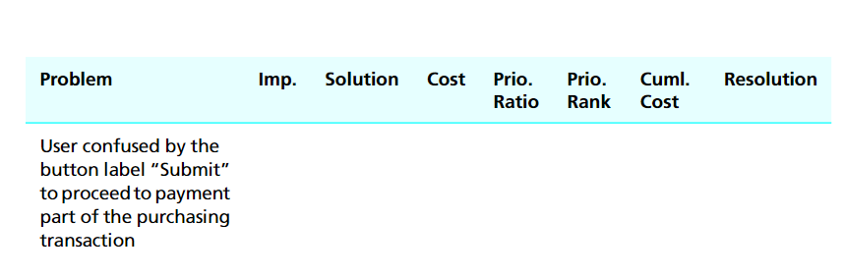
Analyze and report results

Slide 28
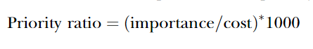
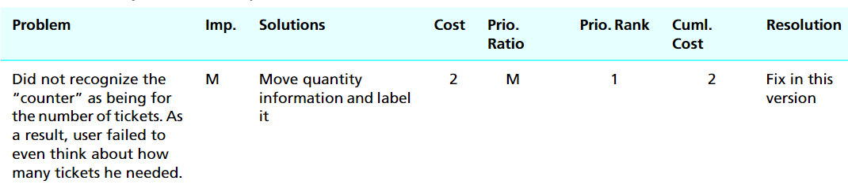
Importance : M(Must Fix), 5 (The most important problems to fix after the “Must fix” category,3 (Moderate) ,1 (Low Impact).
Costs for our analysis are stated in terms of resources (e.g., time, money) needed, which almost always translates to person-hours required.
If the importance rating is “M” (for “must fix regardless”), the priority ratio is also “M.” For all numerical values of importance, the priority ratio becomes:
Each problem enter an amount that is the cost of fixing that problem plus the cost of fixing all the problems above it in the table.

